Slide 1

Smart Data Exploration Hub:
An AI-Powered Chatbot Application
Jake Zappala², Aparna Radhakrishnan¹, Soelem Aafnan Bhuiyan¹, Aria Radick²
(1) Princeton University CIMES, (2) SAIC
GFDL Data Science Group

Slide 2
Acknowledgement
SPEAR Forward Looking Projections IRA Funding
NCEI
Special Thanks
Ramaswamy V., Whit A., Lauren K., Amanda M., Dan B., Tom D., Hiro M., Russell V., Andrew R., Chandin W., Ian L., MSD, NOAA Climate Projections Task Force, and many more!
Project outreach page: Here

Slide 3
Key Terms
SPEAR - (Seamless System for Prediction and EArth System Research)
  NOAA GFDL’s Earth system model for seasonal to long-scale climate prediction and projection.
LLMs - (Large Language Models)
  A neural network trained in large text datasets to generate and interpret human language.
MCP - (Model Context Protocol)
  A standardized interface enabling LLMs to securely interact with data and tools.
RAG - (Retrieval-Augmented Generation)
  A technique that grounds AI responses using retrieved documents.
STAC - (SpatioTemporal Asset Catalog)
  A standardized metadata framework for indexing and accessing geospatial datasets.

Slide 4

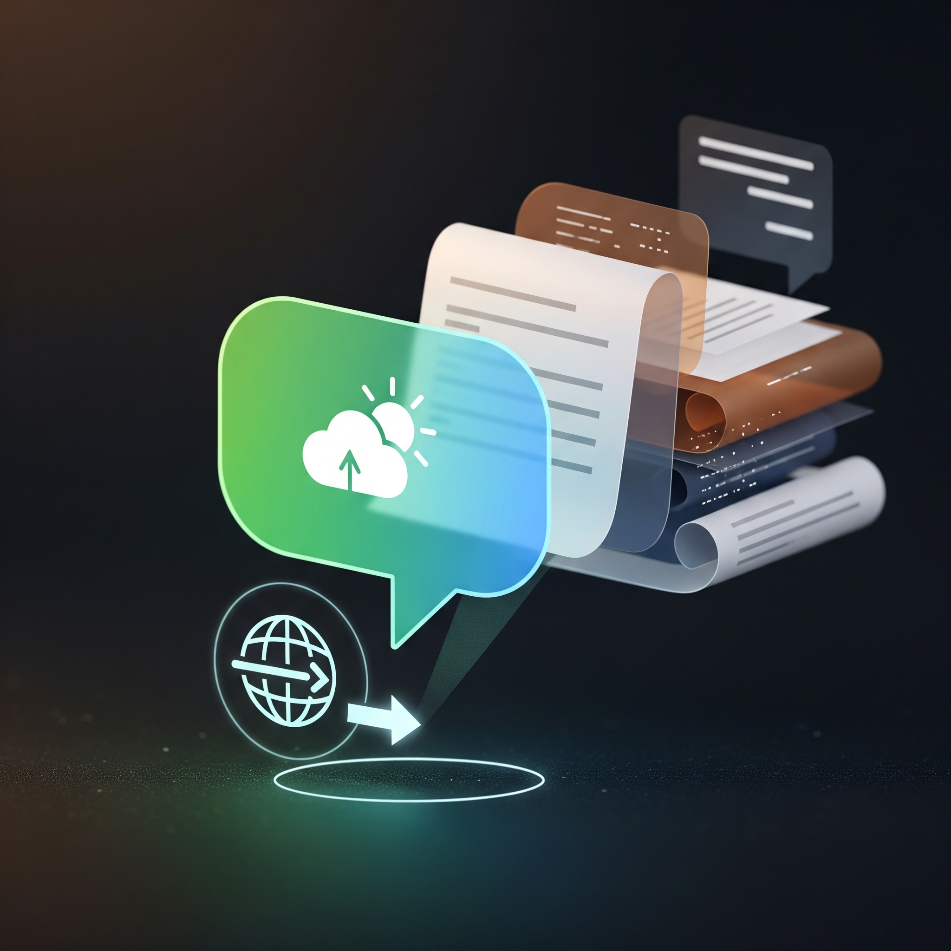

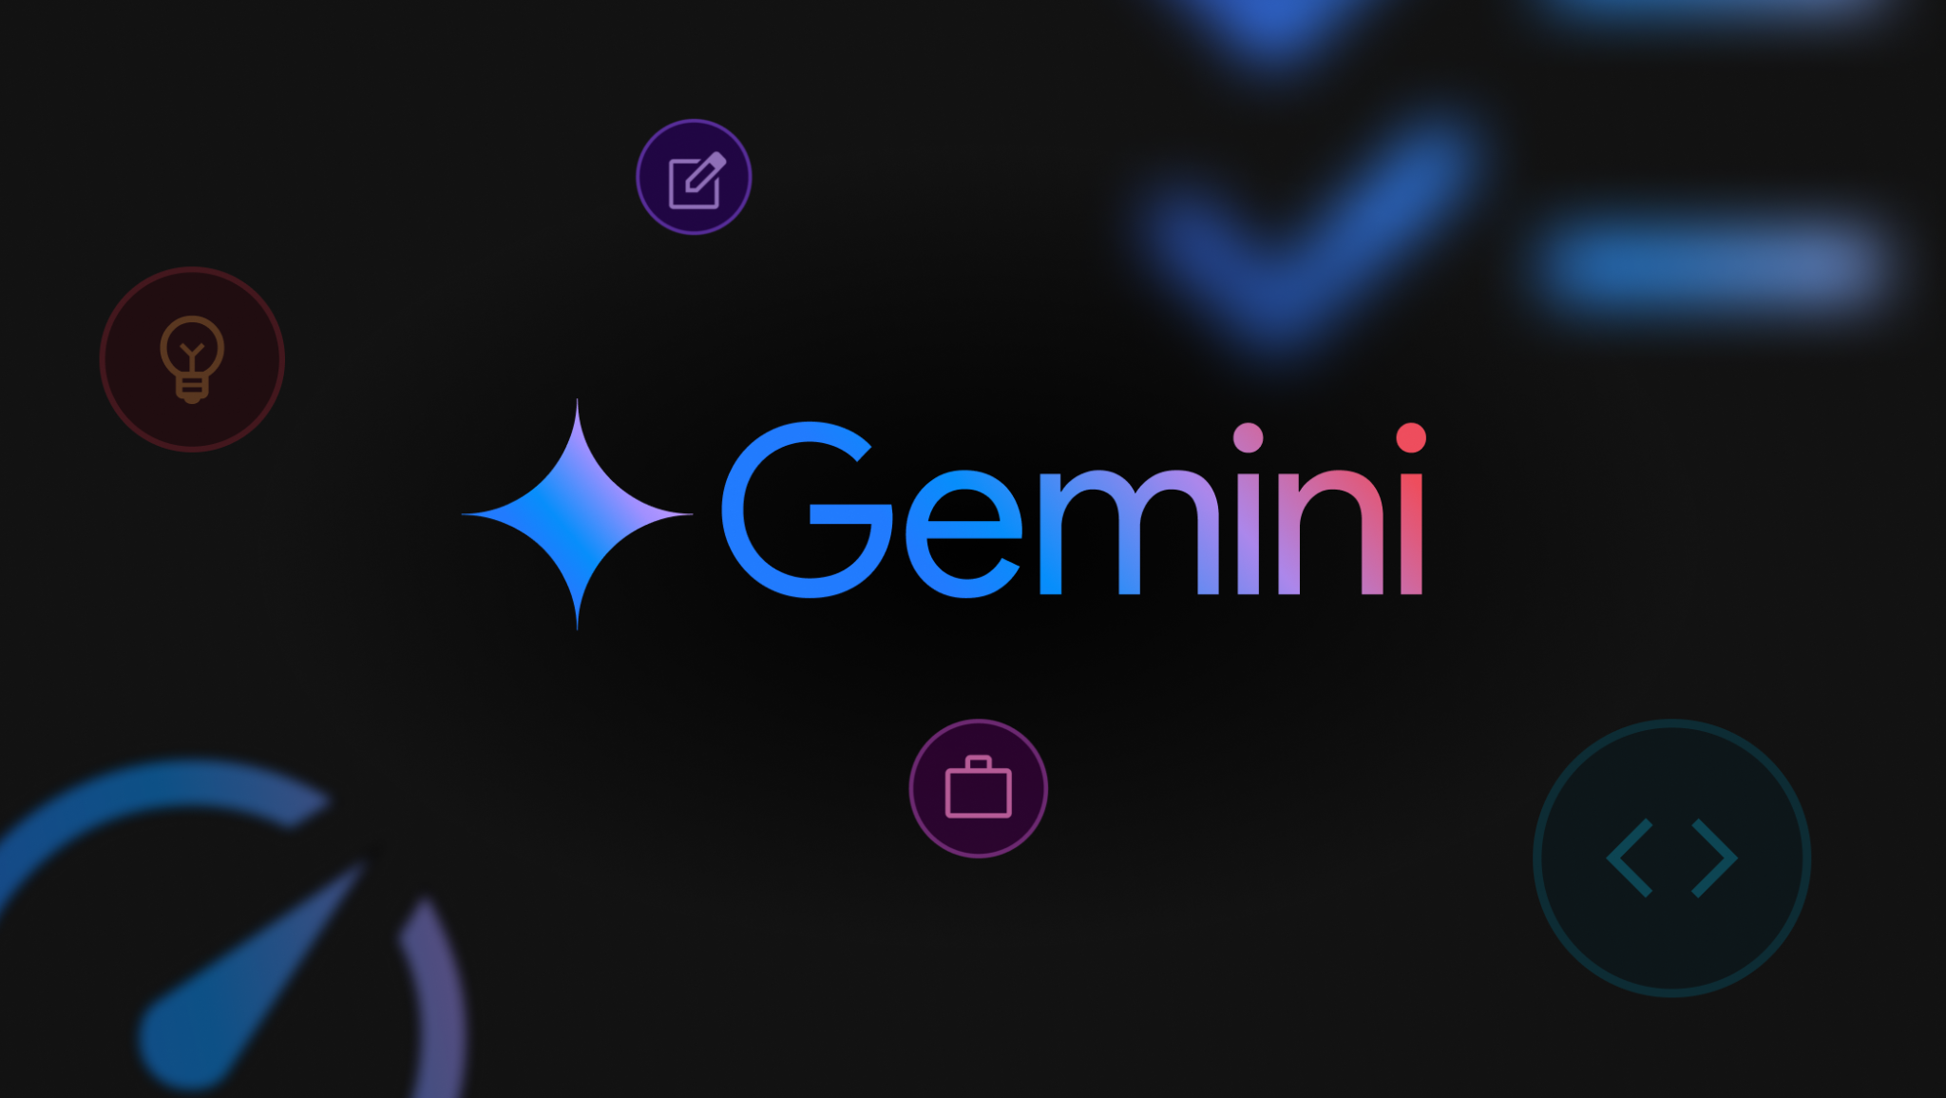
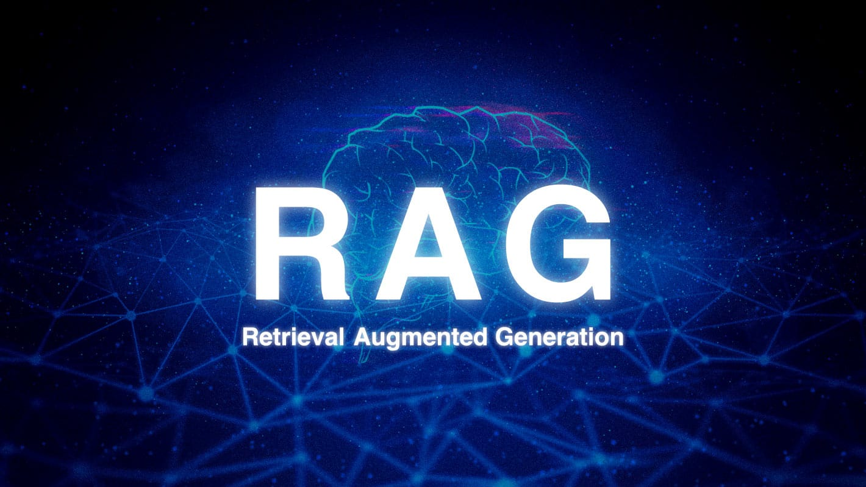
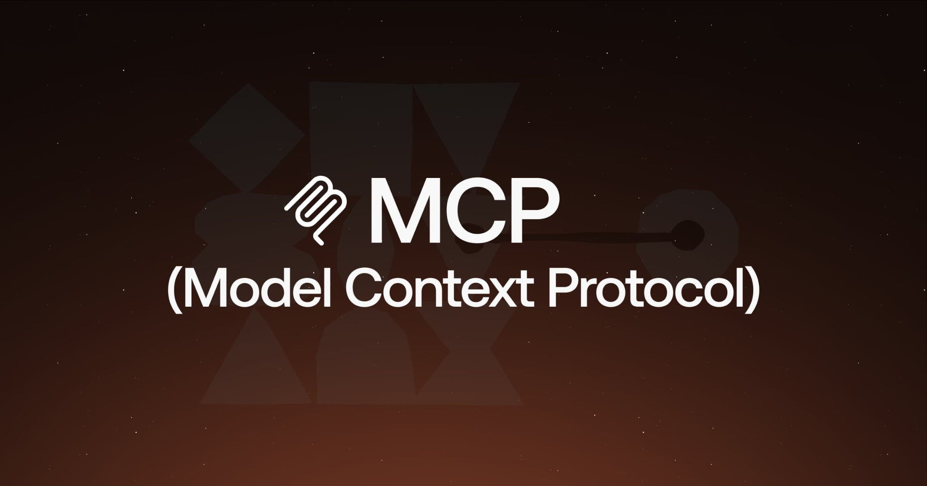
The Why, What and How
Why
What
How
To expand access to SPEAR large-ensemble earth system data and insights.
SPEAR Earth System Data Assistant, publicly accessible with grounded responses from supplied documentation.
Streamlit,
Large Language Models,
Model Context Protocol,
Retrieval-Augmented Generation.

Slide 5

Providing Insight and Lowering Barriers to SPEAR Results
Goals:
Making earth system model data more reachable.
  For those with AND without climate/science backgrounds.
Continuous user engagement and enhanced service delivery.
Building best practices for others with similar interests.
  Publicly available on Github with clear documentation.
To provide a conversational method of inspecting, extracting and analyzing SPEAR output.

Slide 6

Grounded Responses Using Supplied Documentation
Credible and reproducible AI responses are paramount.
Explicit instructions for increased safety.
  Restricted discussion topics.
  Use of responsible AI tools.
Responses based on provided documentation and training base knowledge.
Qualitative confidence estimates for responses.
Future steps include pre-computed diagnostic plots.

Slide 7
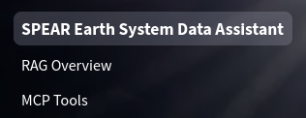
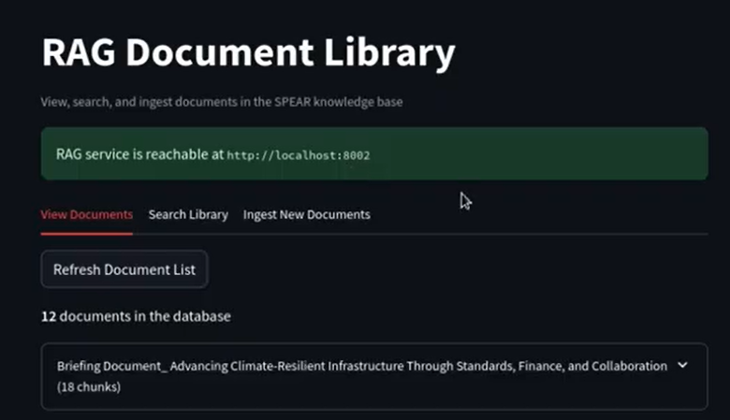
Increased Transparency in AI Responses
Users are informed about the sources of content used in responses.
Ability to view and read the documents in the chatbot supplemental knowledge base.
Interactive overview of data extraction tools and files used to generate tables, plots or analysis.
Ability to investigate sources with two additional tabs:
  RAG Overview
  MCP Tools

Slide 8
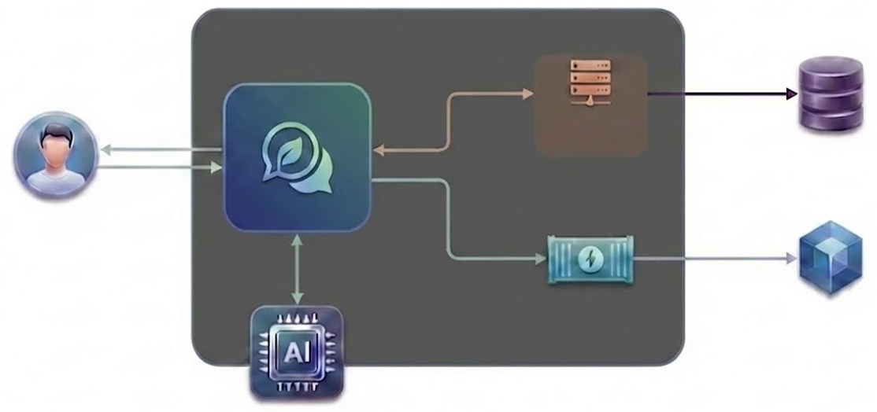
SPEAR Earth System Data Assistant
SPEAR Earth System Data Assistant Pod
MCP Tools
Streamlit UI
MCP Server
Container
HTTP
SPEAR Output Database
User
Container
Python
Function Calls
HTTP
API
RAG Retrieval Server
Container
Chroma Database
LLM

Slide 9
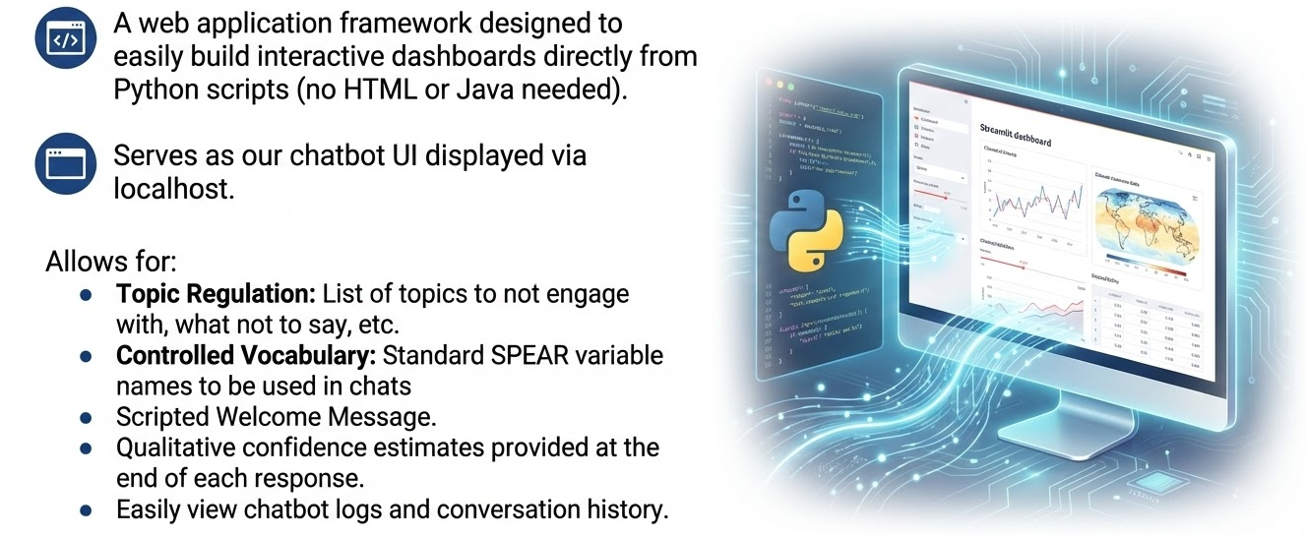
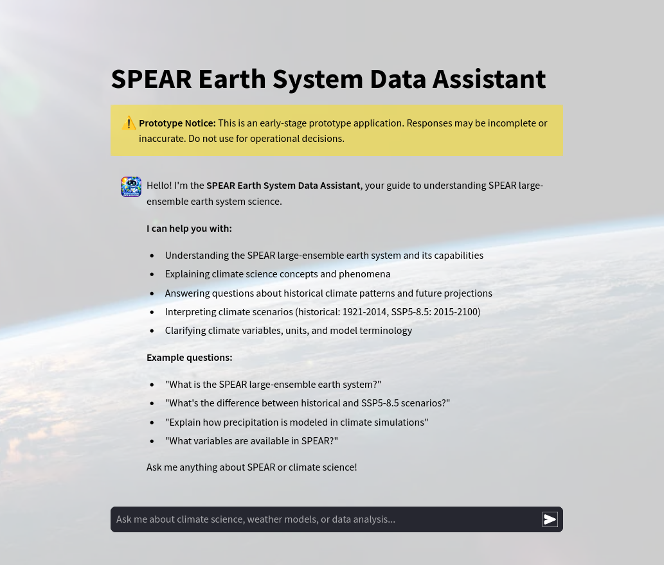
Streamlit UI
A web application framework designed to easily build interactive dashboards directly from Python scripts (no HTML or Java needed).
A web application framework designed to easily build interactive dashboards directly from Python scripts (no HTML or Java needed).
Serves as our chatbot UI displayed via localhost.
Allows for:
Topic Regulation: List of topics to not engage with, what not to say, etc.
Controlled Vocabulary: Standard SPEAR variable names to be used in chats
Scripted Welcome Message.
Qualitative confidence estimates provided at the end of each response.
Easily view chatbot logs and conversation history.
Serves as our chatbot UI displayed via localhost.
Allows for:
Topic Regulation, Controlled Vocabulary, Multi-User Support and Authentication
Scripted welcome message.
Qualitative confidence estimates provided at the end of each response.
Easily view chatbot logs and conversation history.

Slide 10



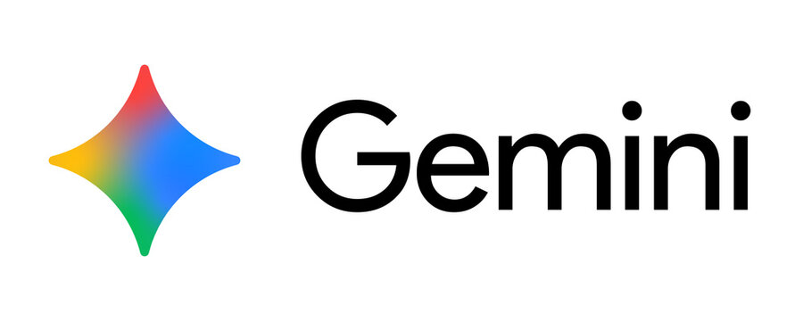
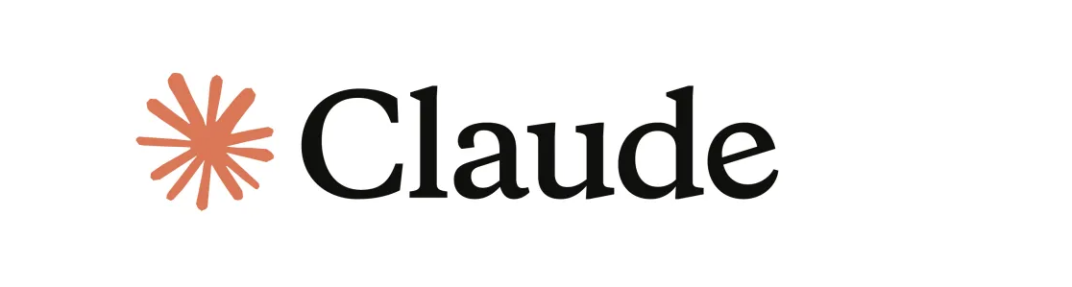
Large Language Model (LLM)
Compatible with locally and remotely hosted models.
Local Ollama
  Llama, Qwen, Gemma
Remote API
  Gemini, Claude
Handles response generation and tool execution.
Decides between RAG content or MCP tool usage.

Slide 11
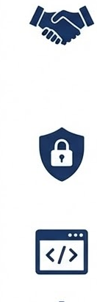
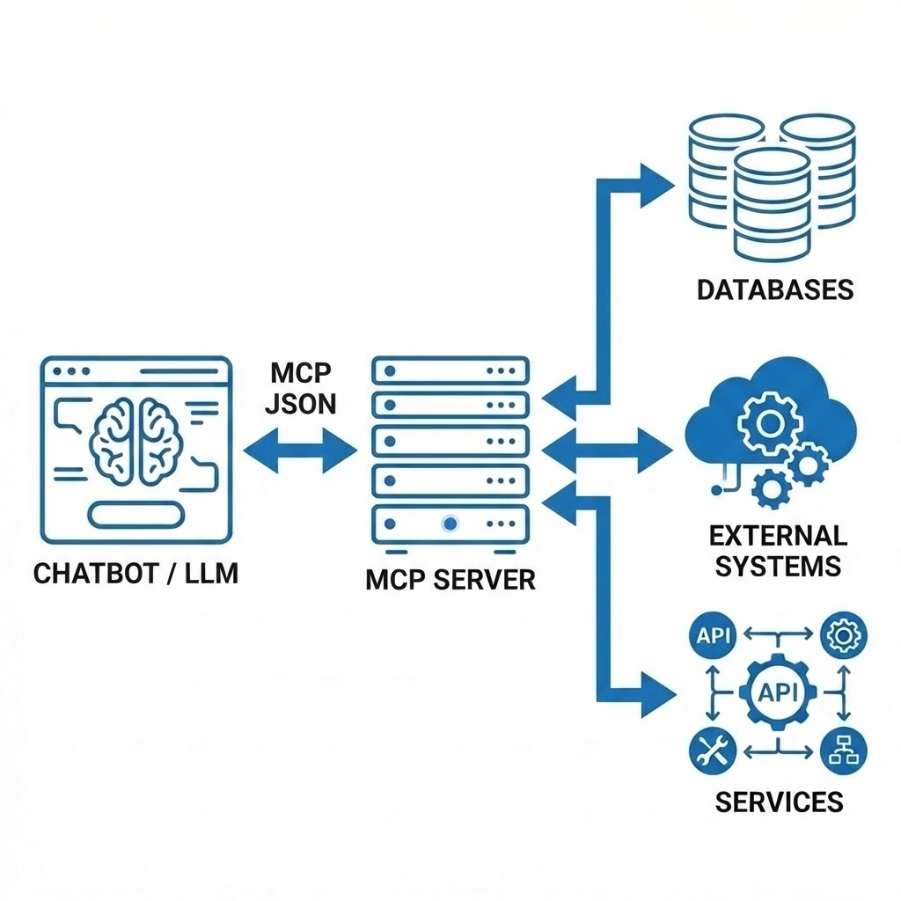
Model Context Protocol (MCP)
A standardized communication method that enables Large Language Models (LLMs) to exchange information with external systems, databases and services.
Image here
Provides secure and structured access to data and tools that would otherwise be unavailable to AI models.
Uses a simple JSON format for consistent interoperable communication (HTTP).

Slide 12
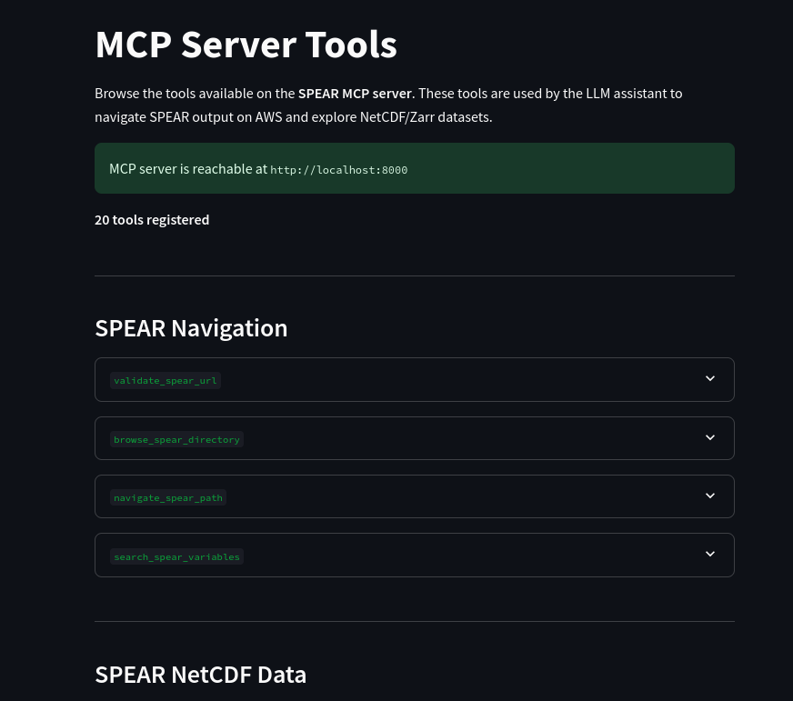
The SPEAR Earth System Data Assistant MCP Server
Tools for NetCDF inspection and extraction
  Metadata
  Data arrays
  Directory and file browsing
3 different server configurations
  AWS cloud
  Locally mounted filesystems
  SpatioTemporal Asset Catalogs (STAC)

Slide 13


Retrieval-Augmented Generation (RAG)
Retrieves info from trusted documents before responding.
Ensures answers are grounded in SPEAR and stakeholder documentation, such as ASCE.
Reduces hallucinations and improves factual accuracy.
Allows the chatbot to answer questions using up-to-date, project-specific information.
3 primary stages to RAG.

Slide 14
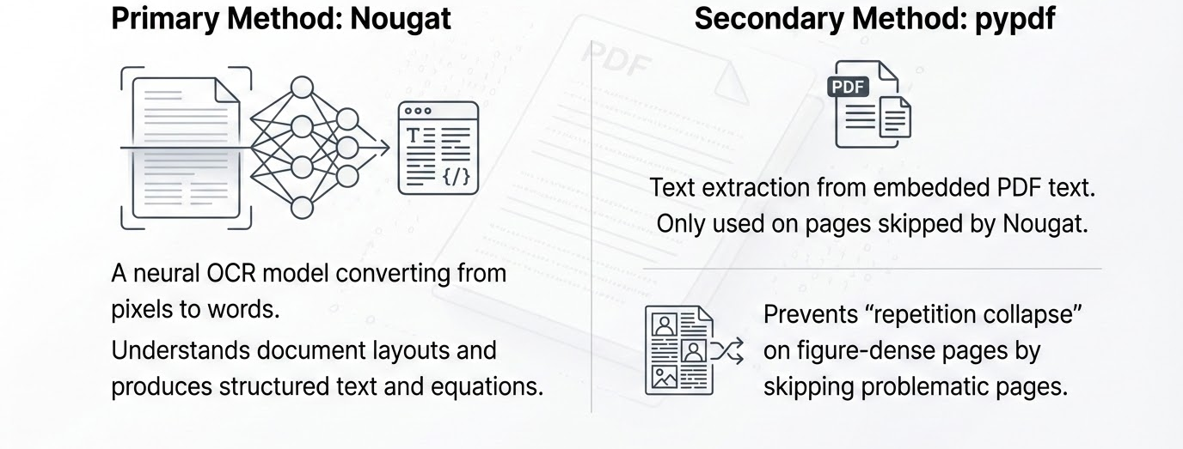
RAG: Stage 1
Text Extraction from PDF
Extracts embedded PDF text. Only used on pages skipped by Nougat.
A neural OCR model converting from pixels to words.
Understands document layouts and produces structured text and equations.
Prevents “repetition collapse” on figure-dense pages by skipping problematic pages.

Slide 15
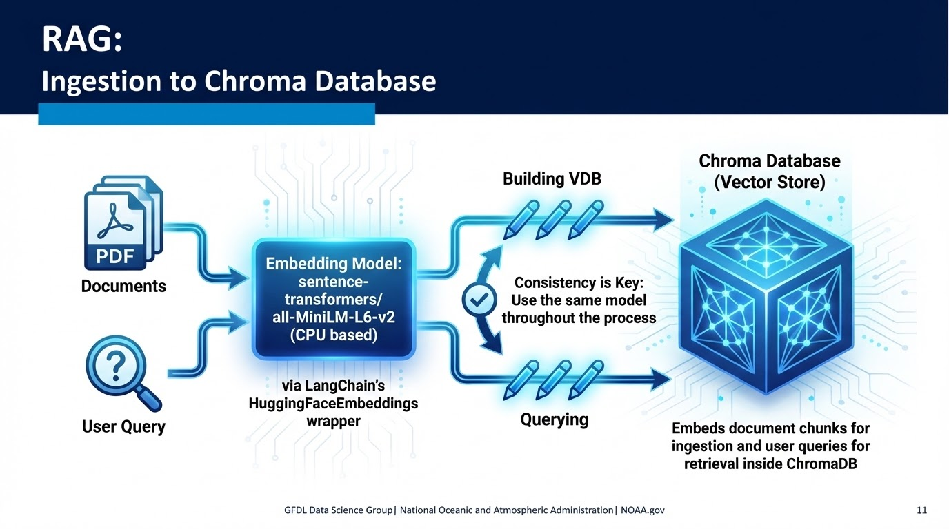
Stages 2 and 3
Ingestion and Retrieval from Chroma Database
Ingestion
Retrieval

Slide 16
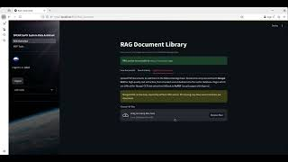
SPEAR Earth System Data Assistant:
Live Demo
*If video is blurry,
set playback quality to 1080p^{HD}

Slide 17
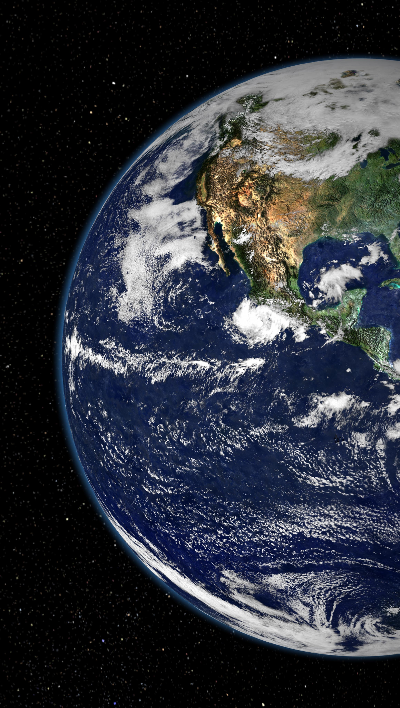
On the Horizon
Reduce computational load.
  Pre-computed diagnostic plots.
Optimize data interactions.
  Zarr and Icechunk, instead of NetCDF.
Fine-tuning of a locally run LLM.
  Benchmarking included.
    Figure generation enhancements (manuscript ready plots).

Slide 18
Github Repositories
Streamlit UI:
  https://github.com/zappalaja/spear-climate-chatbot
MCP Server:
  https://github.com/zappalaja/spear-mcp-test
RAG Ingestion:
  https://github.com/zappalaja/SPEAR-RAG-Ingestion
RAG Retrieval Service:
  https://github.com/zappalaja/SPEAR_RAG_Retrieval_Service
Full SPEAR ESDA (all components above):
  https://github.com/zappalaja/SPEAR_Earth_System_Data_Assistant
SPEAR AWS Output
  https://noaa-gfdl-spear-large-ensembles-pds.s3.amazonaws.com/index.html#SPEAR/GFDL-LARGE-ENSEMBLES/CMIP/NOAA-GFDL/GFDL-SPEAR-MED/

Slide 19
Questions?
Submit questions/feedback anytime: https://bit.ly/4lF1rT1
Contact Info
jake.zappala@noaa.gov
linkedin.com/in/jake-zappala/

